Slide 1
Player Session Segmentation
Improvements delivered by machine learning

Slide 2

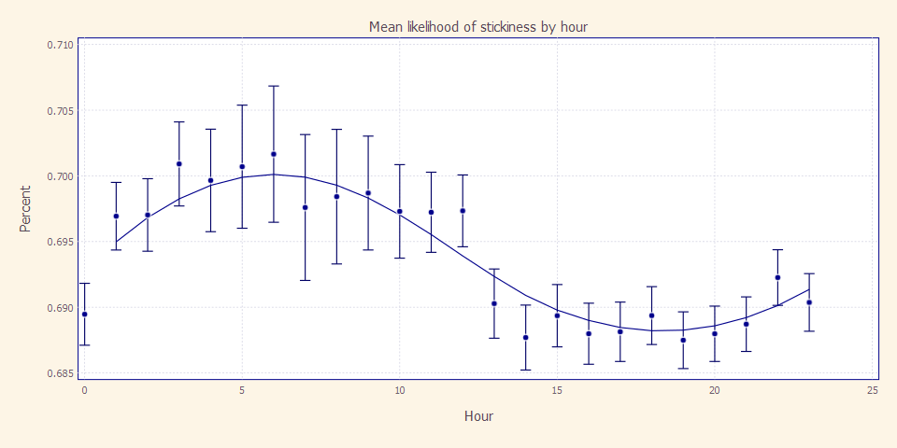
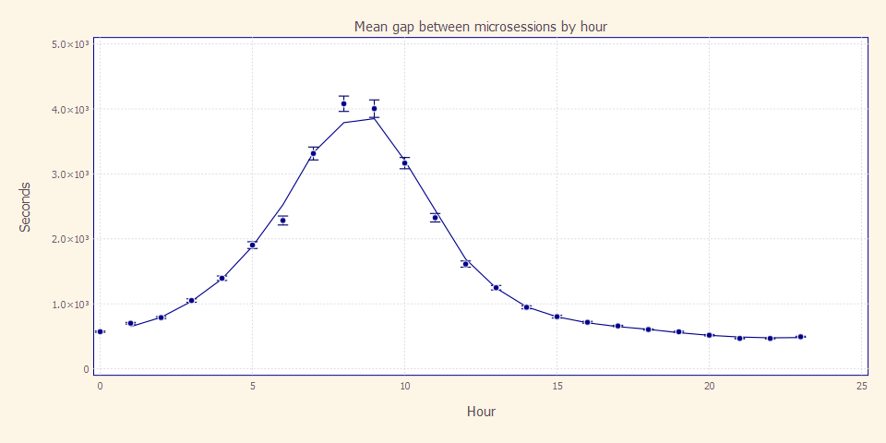
Time gap between microsessions

Slide 3
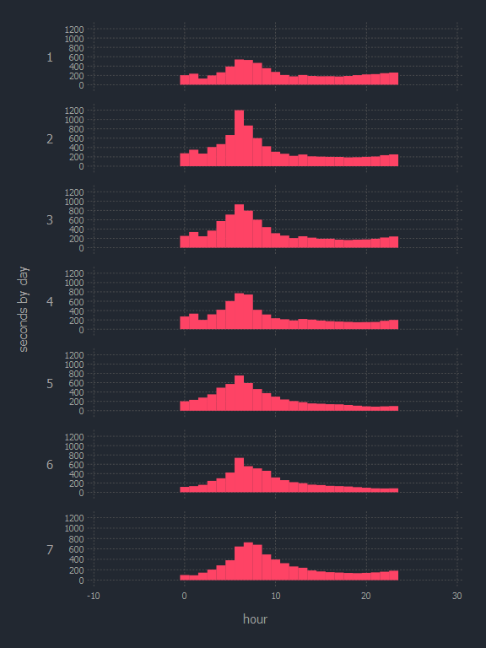
Hour by Hour Gap Times by Day

Slide 4
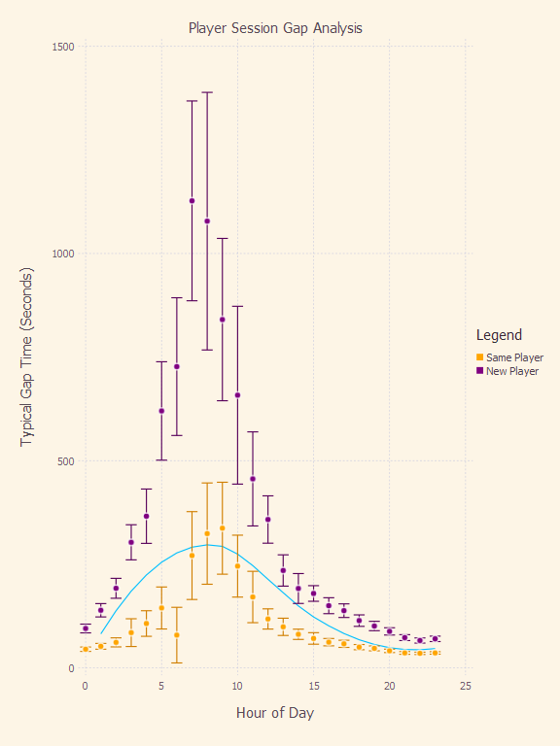
Same Player Gap vs. New Player Gap

